Slide 1

Chapter 3
Designing and Developing an Agent-based
Model

Slide 2
Learning Objectives
Understand the full breadth of considerations needed when designing an agent-based model
Apply a design process in creating a segregation model

Slide 3
Lecture Outline
Designing ABMs
Overview
World
Interactions
Agents
Other Frameworks

Slide 4
Designing ABMs
The design of agent-based models is an iterative process, where we integrate theory and data in aiming to explain and predict social systems
While calibration and validation (covered later in the course) can help us tweak model parameters and improve fit, an ABM requires a strong underpinning design
In this lecture, we focus on the considerations required in the design of an ABM

Slide 5
Design Framework
In this book, we introduce a loose framework for ABM design, set into four levels of hierarchy:
Overview – Relating broadly to the wider aims and definitions of the simulation as well as practical considerations
World – Involved with designing the model of the world in which the simulation will take place
Interactions – Design of the nature of interaction and exchange between agents, and the impact on model dynamics
Agents – How agent behavior is designed and encoded at the individual level
Each stage leads to decisions that influence subsequent designs, thus it is advised that this process is conducted in this order

Slide 6
Lecture Outline
Designing ABMs
Overview
World
Interactions
Agents
Other Frameworks

Slide 7
Purpose and Process
The very first thing you should do when designing an ABM is explicitly specify:
the purpose for the simulation – why is the simulation needed, and what new is going to tell you about the world?
and the process being simulated – what process will be simulated?
There is a vast diversity of potential responses to these questions, and the answers are likely to be intuitively simple
However, they are important screening questions prior to embarking on ABM development – remember ‘just because you can build an ABM, doesn’t mean you should…’

Slide 8
Data Collection and Evaluation
Once you have your ABM idea in mind, you should think about the datasets you could use to calibrate and validate your modelling
These choices are constrained by context and availability, but thought should also be given over to the strengths and limitations of alternative sources
Having a rough idea of the type of evaluation you’d like to conduct (and will be accepted by your peers) is a good idea at this stage – more details on these considerations follow in a later lecture

Slide 9
Development and Software
How will you develop your ABM? There are lots of packages available, and it is important to examine the strengths and weaknesses of each
Consider simulation scale and computation requirements, and extensions of existing models
It also helps if you can already code in the language the framework uses!

Slide 10
Visualisation
Visualisation will typically come at the end of your ABM development, but it’s important to consider it here
The outputs from your model will influence the scale of development and the software it is developed in
Game development software idea for 3D ABM

Slide 11
Lecture Outline
Designing ABMs
Overview
World
Interactions
Agents
Other Frameworks

Slide 12
External Systems
Any ABM has a window of focus, with factors outside of that window simplified in some way
At this point, we identify the area of focus, and the assumptions we make in relation to external systems
Example
Simulations of pedestrian movement focus on street-level interactions, and therefore make assumptions about behaviors outside of this window of interest
We could adopt simplified gravity-based models or historic data to generate origin-destination flows, and we might ignore aspects of agent mood or the football team they support that are uncertain or not relevant to pedestrian movement

Slide 13
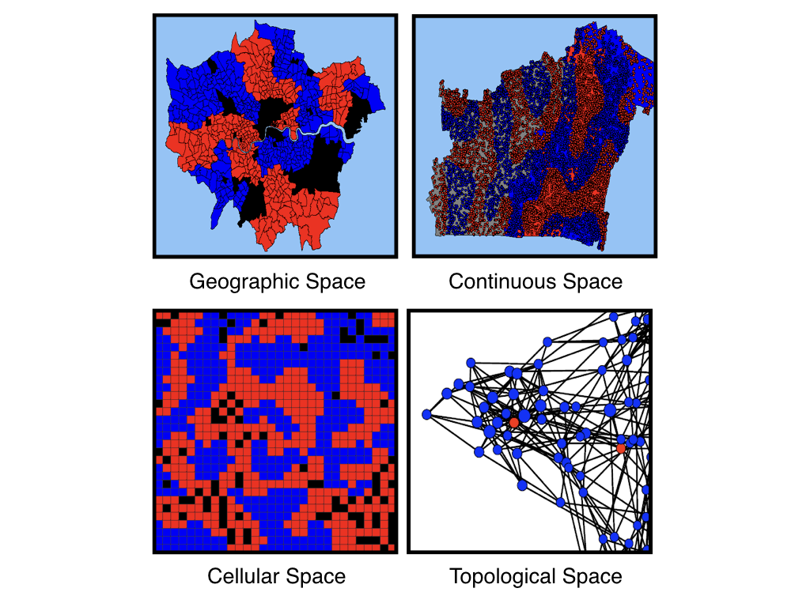
Space
Space can be represented in different ways – tied to real world geographies, or abstract associations
Geographic space will typically draw on GIS datasets
Topological space, also known as network space, represents abstract links between agents (e.g. social networks, trade relations)

Slide 14
Time
Time definitions relate to the dynamics of the modelled system
The simulated ‘time step’ relates to the period of time between simulation updates, or how often an agent might change behaviour
The frequency of these updates relate to the context, but could vary from milliseconds to days and years
Choice of time step influences how long your model will take to run
A traffic model might update the position of vehicles every second
A migration simulation could update movements on a monthly basis

Slide 15
Populations
At this point we should roughly define how many agents will be modelled within the ABM
These definitions help with the later specification of the model, but more specific definitions about the agents are made at lower levels in the hierarchy

Slide 16
Physical Rules

Slide 17
Lecture Outline
Designing ABMs
Overview
World
Interactions
Agents
Other Frameworks

